Slide 1



Inter IIT Tech Meet 12.0
Quantum Computing Challenge
(by Mphasis)
Created By : Team 65

Slide 2

Introduction
In the realm of airline operations, adeptly navigating the intricacies of planned schedule changes is of utmost importance. The main aim is to identify optimal alternative flight options for affected passengers, ensure strict adherence to established regulations, minimise disruptions and preserve service quality, with a specific focus on factors such as travel time, the impact on ancillary services, and the prioritisation of passengers based on various attributes.

Slide 3

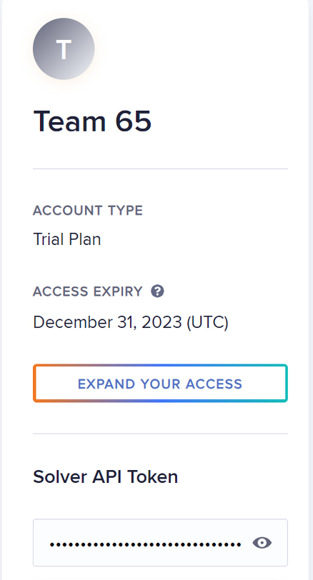
Ready for a Live Demo!?

Slide 4
Minimization of Unresolved PNRs
Goals of the Problem Statement
Adherence to Default Solution
Minimization of Delays
Customer Class Priority Consideration
Preference for Direct Flights

Slide 5

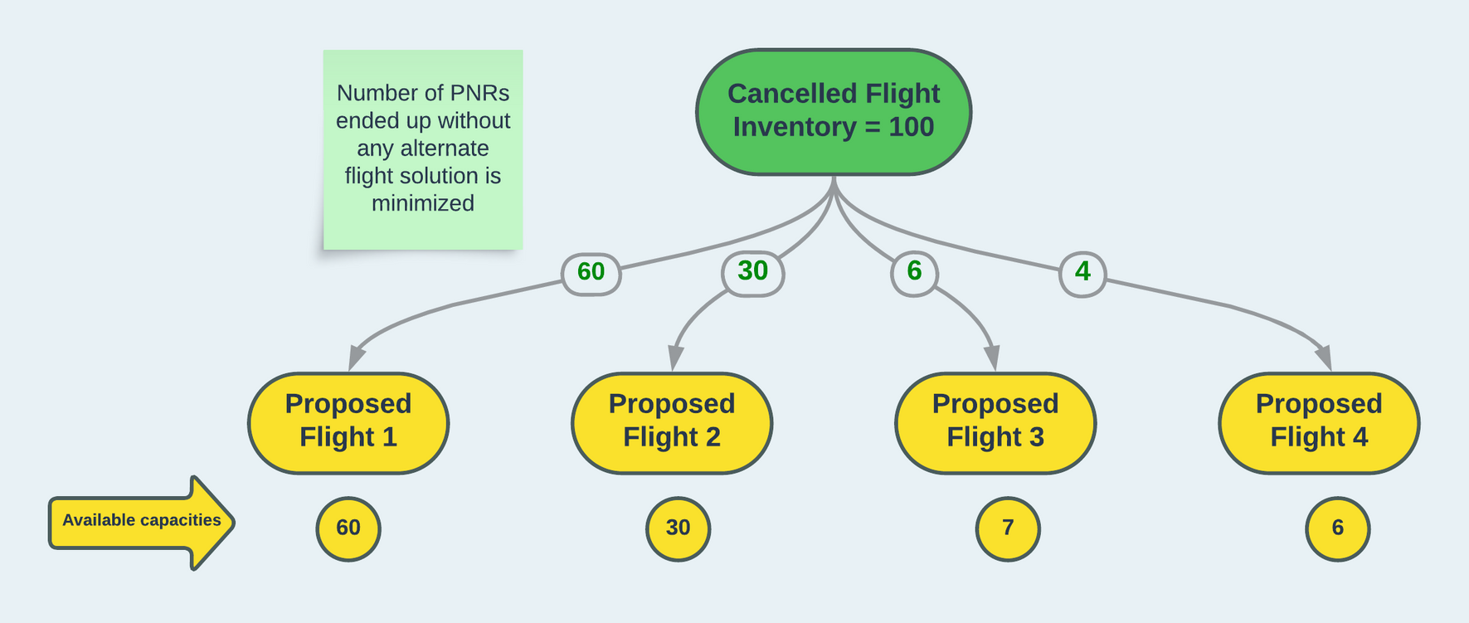
Minimization of Unresolved PNRs
The primary objective of this optimization effort is to minimize the occurrence of unresolved PNRs, ensuring that each passenger affected by schedule changes is provided with a viable alternate flight solution

Slide 6
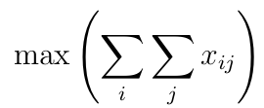
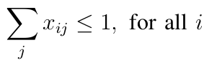
Minimization of Unresolved PNRs
Mathematical Formulation
Decision Variables:
Let xij be a binary variable representing whether Passenger i is assigned an alternate flight solution j. The decision variable takes the value 1 if the assignment is made, and 0 otherwise.
Objective Function:
Minimize the total number of unresolved PNRs:
Constraints:
Each passenger is assigned to at most one alternate flight:

Slide 7
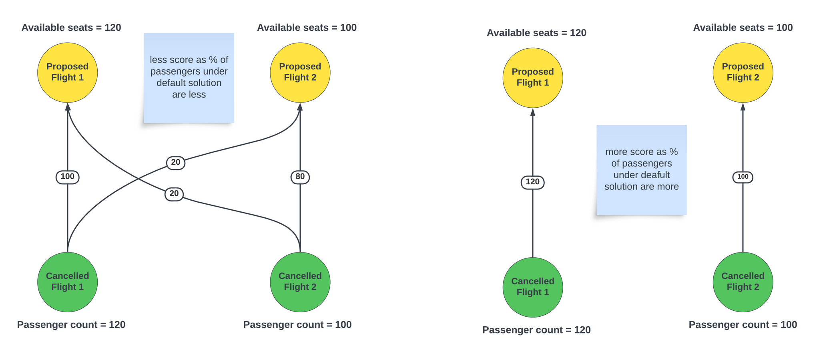
Adherence to Default Solution
Objective: Prioritize strict adherence to the flight-level default solution for PNR reallocation, with the flexibility to accommodate deviations in cases where
capacity constraints demand fine adjustments.

Slide 8
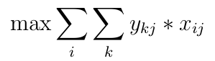
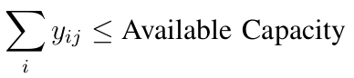
Adherence to Default Solution
Mathematical Formulation
Decision Variables:
Let y kj be a variable representing that k flight is rescheduled on flight j and taking x ij from previous goal.
Objective Function:
Maximize strict adherence to the flight-level default solution while allowing for flexibility:
Constraints:
Capacity constraint adjustments:

Slide 9
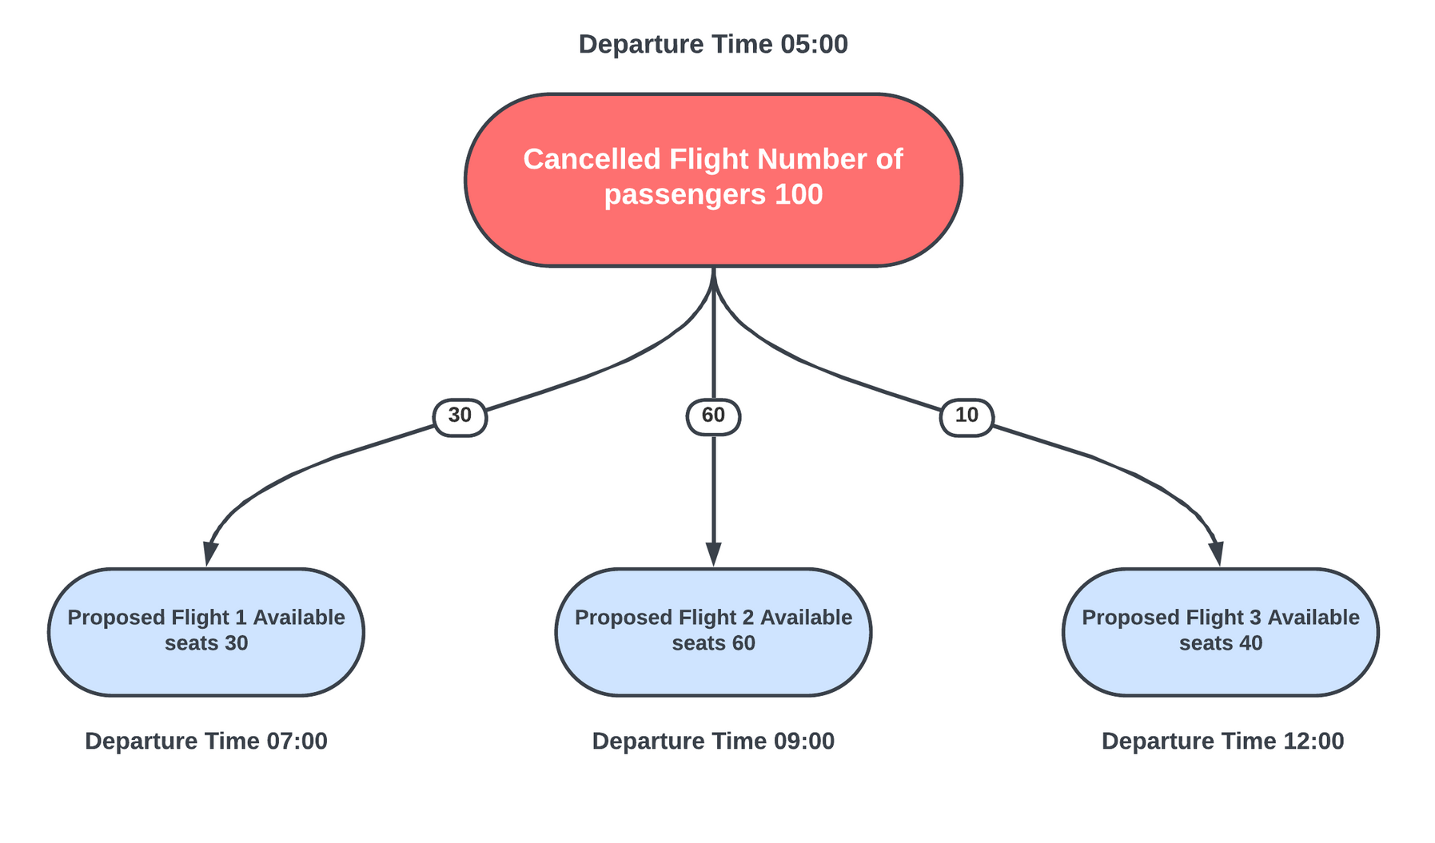
Minimization of Delays
Objective: Systematically minimize the overall delay attributable to the re-accommodation
process, underscoring the significance of timeliness in passenger satisfaction.

Slide 10
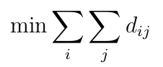
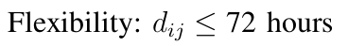
Minimization of Delays
Mathematical Formulation
Decision Variables:
Let d ij represent delay for PNR i on flight j.
Objective Function:
Minimize the overall delay attributable to the re-accommodation process:
Constraints:
Capacity constraint adjustments:

Slide 11
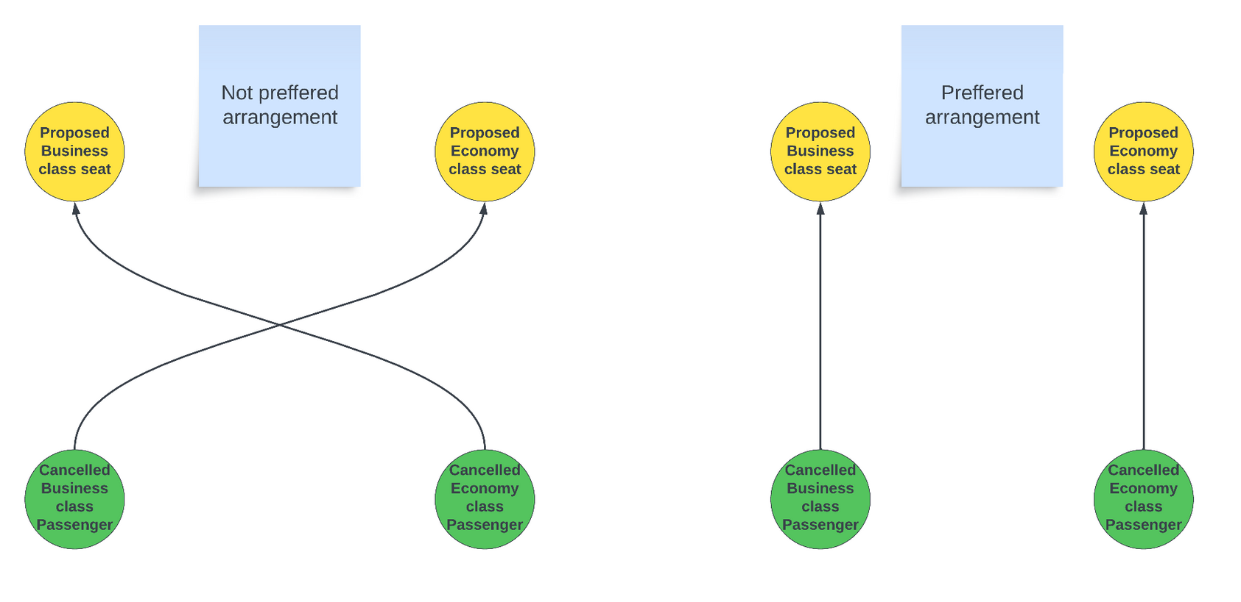
Customer Class Priority Consideration
Objective: Integrate nuanced considerations of customer priority into the reallocation process, affording higher precedence to specific passenger categories, such as business class over economy class.

Slide 12
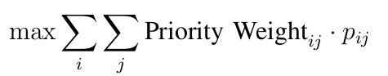
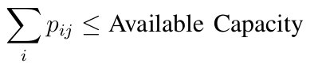
Customer Class Priority Consideration
Mathematical Formulation
Decision Variables:
Let p ij be a binary variable representing whether PNR i is assigned to flight j considering customer class priority. The decision variable takes the value 1 if the assignment is made, and 0 otherwise.
Objective Function:
Maximize the overall customer class priority in the reallocation process:
Constraints:
Capacity constraint adjustments:

Slide 13
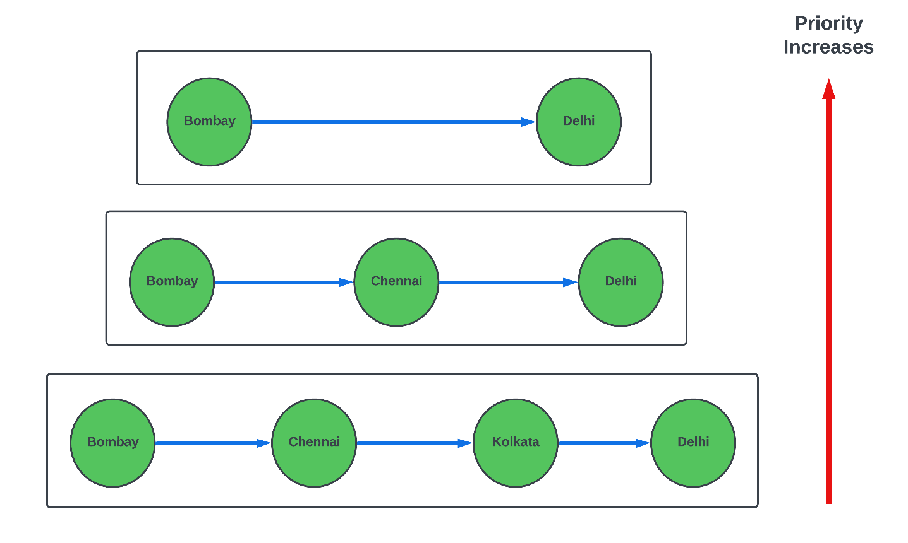
Preference for Direct Flights
Objective: Establish a pronounced preference for direct flights over connecting flights in
the re-accommodation process, accentuating the advantages of reduced travel time and heightened passenger convenience.

Slide 14
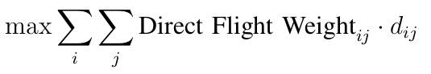
Preference for Direct Flights
Mathematical Formulation
Decision Variables:
Let d ij be a binary variable representing whether PNR i is assigned to a direct flight
j. The decision variable takes the value 1 if the assignment is made, and 0 otherwise.
Objective Function:
Maximize the preference for direct flights over connecting flights in the reaccommodation process:

Slide 15
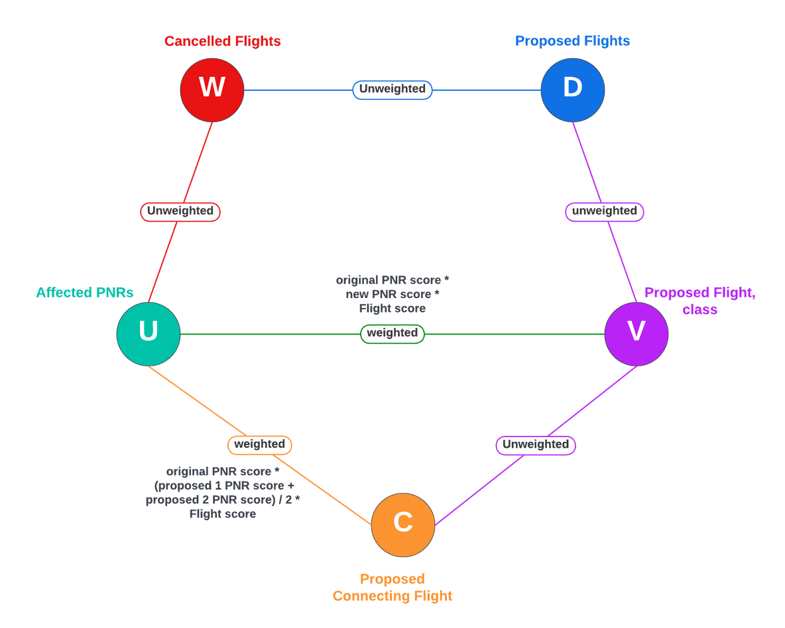
Graphical Representation
W represents set of nodes denoting canceled flights.
U represents set of nodes denoting affecting PNRs.
D represents set of nodes denoting proposed flights.
V represents set of nodes denoting direct proposed flight, class.
C represents set of nodes denoting Connecting proposed flights,class.

Slide 16
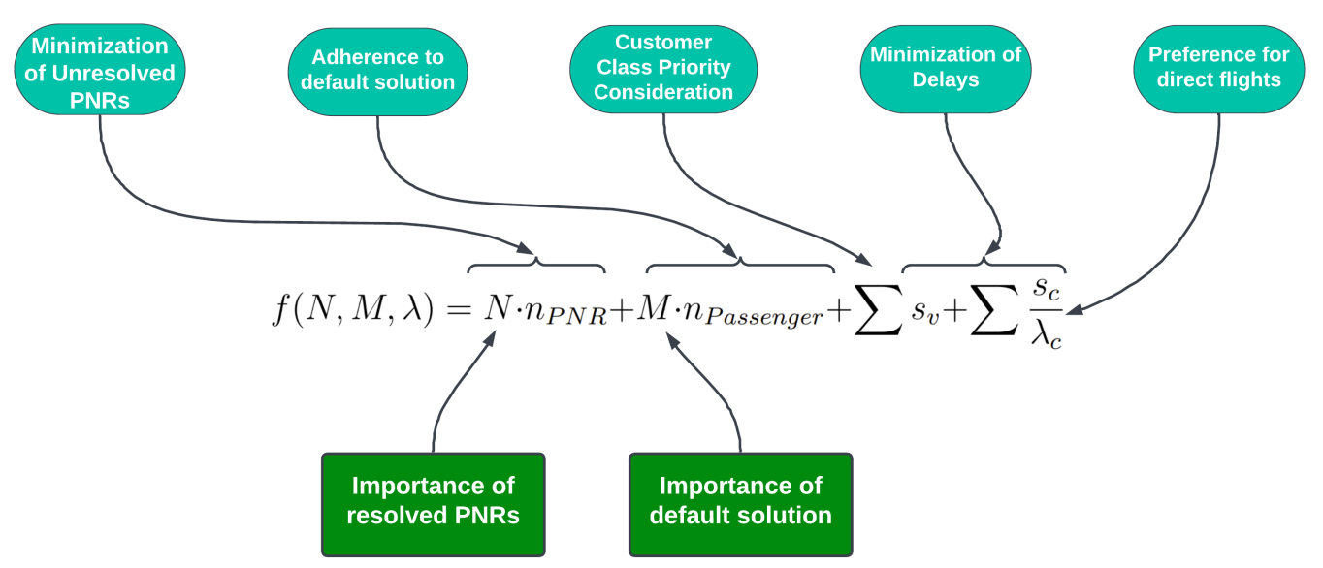
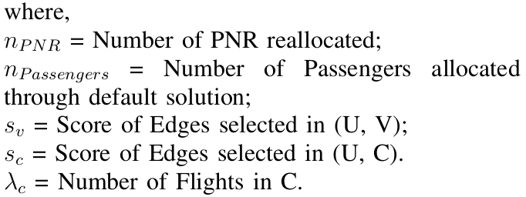
Scoring Function

Slide 17
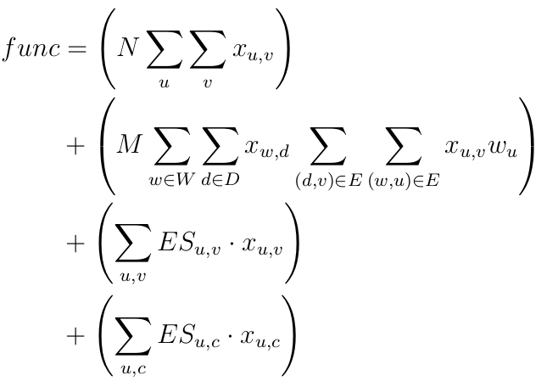
Representing Scoring Function using Boolean Variables
where,
x(u, v) : Boolean variable which tells, if the edge between U to V is selected.
x(w, d) : Boolean variable which tells, if the edge between W to D is selected.
x(u, c) : Boolean variable which tells, if the edge between U to C is selected.
w(u) : Constant node weight, for every node in U.
ES(u, v) : Edge Score of an edge from U to V.
ES(u, c) : Edge Score of an edge from U to C.
N, M : Scaling Factors.

Slide 18
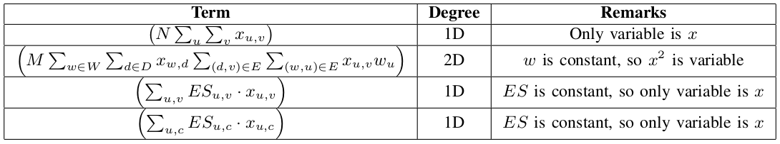
Analysing the Scoring Function

Slide 19
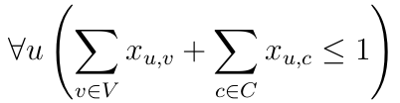
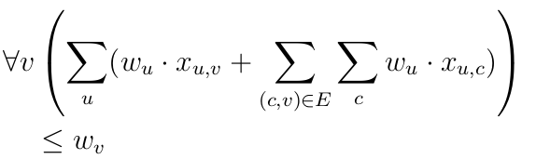
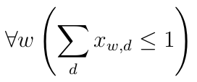
Final Deduced Constraints
At most one alternative flight solution is selected for each passenger in U, representing all impacted PNR(s) which ensures an effective reallocation of alternate flights for every affected passenger. Here x (u,v) and x (u,c) are boolean representations of existence of edge in (U, V ) and (U, C) respectively.
It is imperative to ensure that seat allocations do not exceed the available number of seats, maintaining a meticulous alignment between the number of seats allocated and the actual capacity.
Let D denote the set comprising all proposed flights for rescheduling, and W represent the set of cancelled flights. A critical constraint demands that each cancelled flight, residing within set W, be exclusively assigned to a single new rescheduled flight from the set D.

Slide 20
Using Hubs
Information for busy airports is stored and this is fetched for all cancelled flights to generate connections.
Connecting Flight Heuristics
Using Flight Generation
For all affected journeys, possible connections are generated with data fetched for flights from source and to destination and applying constraints.
Using Multisource BFS
Graph with all flights following set constraints is generated. BFS is applied to find multi-legged connections.

Slide 21
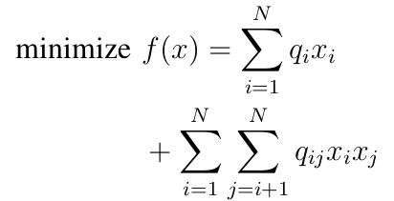
Definition:
QUBO: Quadratic Unconstrained Binary Optimization.
Mathematical framework for optimization with binary variables (0 or 1).
Objective: Minimize or maximize a quadratic objective function.
What is QUBO ?
Mathematical Formulation:
General QUBO equation:
where x i is a binary variable, q i is the linear coefficient, and q ij is the quadratic coefficient.

Slide 22
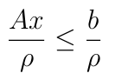
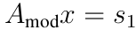
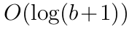
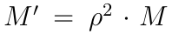
Transform the Inequality
Approximate the Right Hand Side
Reduction to QUBO & Constraints Handling
Binary Expand Slack Variable
Adjust the Penalty Coefficient
Construct QUBO

Slide 23
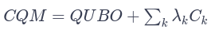
CQMs extend the QUBO framework to incorporate constraints. The formulation of CQM involves modifying the QUBO objective function to include penalty terms for violating constraints. The augmented CQM is given by:
Here, Ck​ represents the constraint functions, and λk​ represents penalty coefficients associated with each constraint.
CQM (Constrained Quadratic Model)
CQM Conversion: The conversion process typically involves transforming high-level problem descriptions into mathematical expressions compatible with the CQM framework.
Benefits of CQM Conversion:
Automation: CQM streamlines the conversion process, reducing the need for manual intervention.
Accuracy: Automation helps minimize the risk of introducing errors during the conversion of complex mathematical expressions.

Slide 24

Using Quantum Computing to solve QUBO
D-Wave Leap
D-Wave’s cloud-based service for remote access to quantum processors.
Users submit problems in QUBO or Ising models for solving using quantum annealing.
Leap Hybrid Solver
D-Wave Leap’s Hybrid Solver is a cloud- based service that seamlessly blends classical and quantum processing.
It harnesses the power of D-Wave’s quantum processing unit (QPU) in conjunction with classical computing, providing an effective and accessible solution for addressing optimization problems in diverse real-world applications.

Slide 25

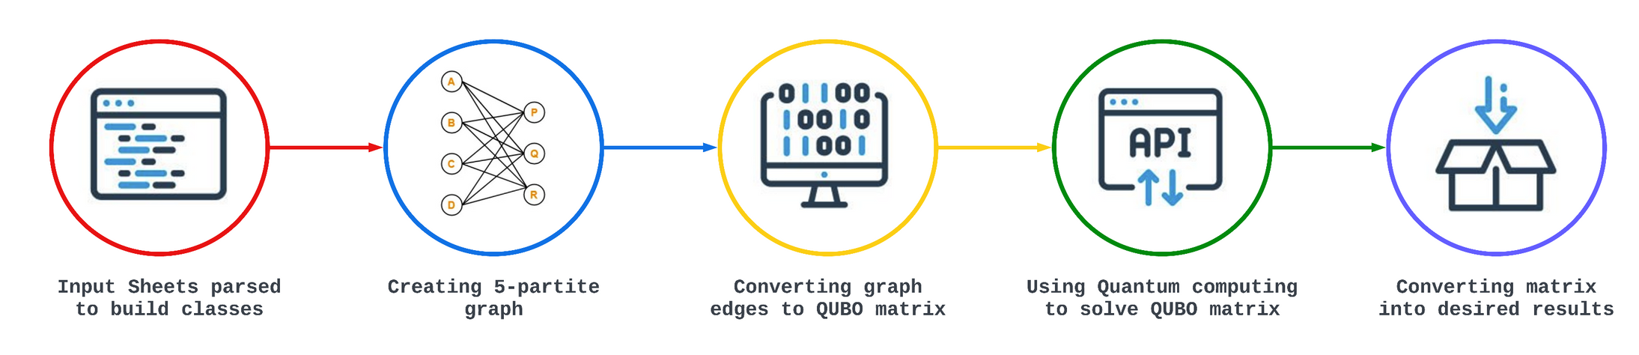
Workflow

Slide 26
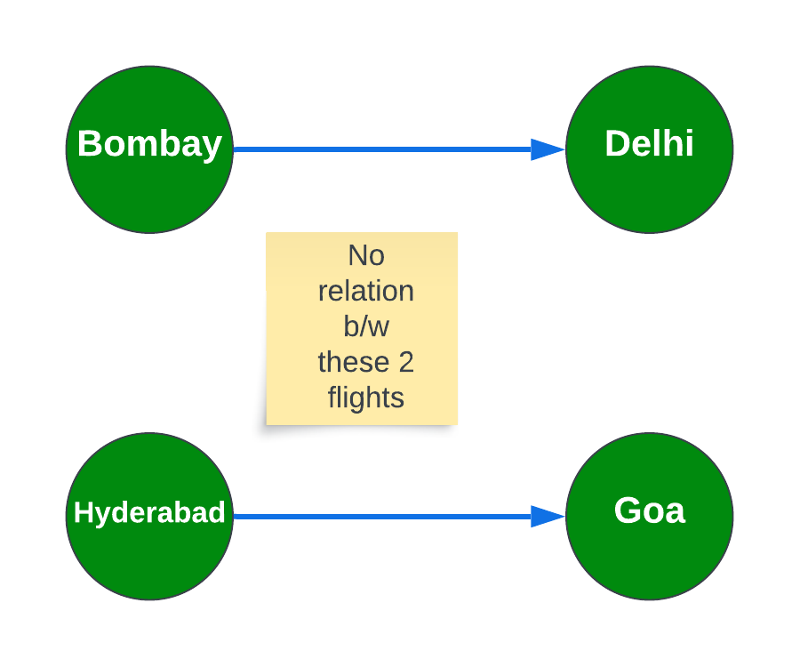
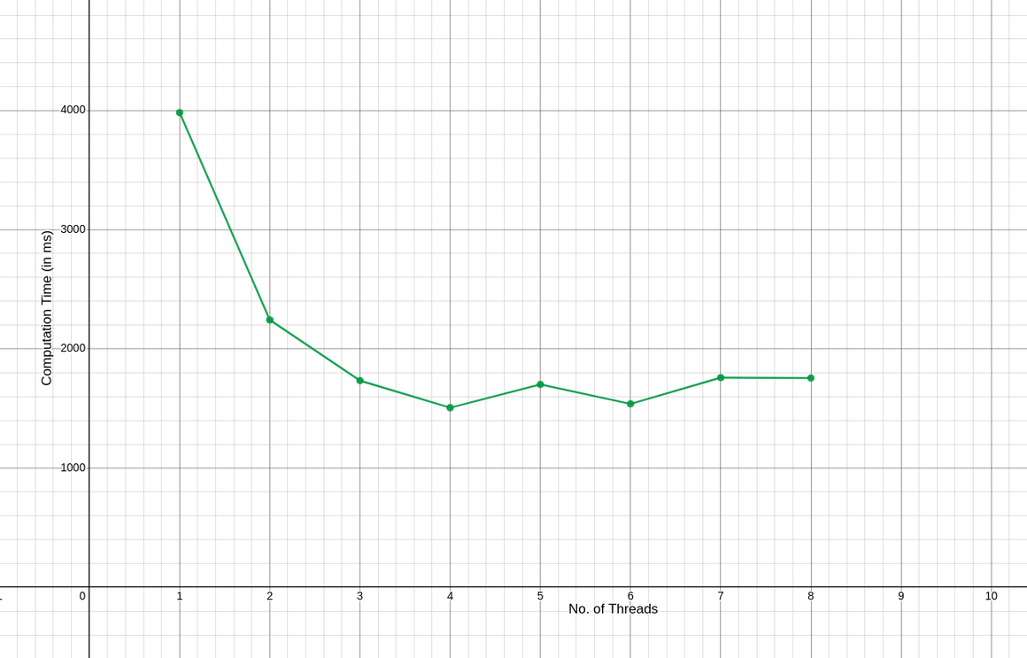
Optimizations
Breaking Problems into SubGraphs
Use of Multithreading to solve different subgraph problems

Slide 27
1% Flights to affected
2% Flights to affected
Experiments Done
5% Flights to affected
10% Flights to affected
20% Flights to affected

Slide 28
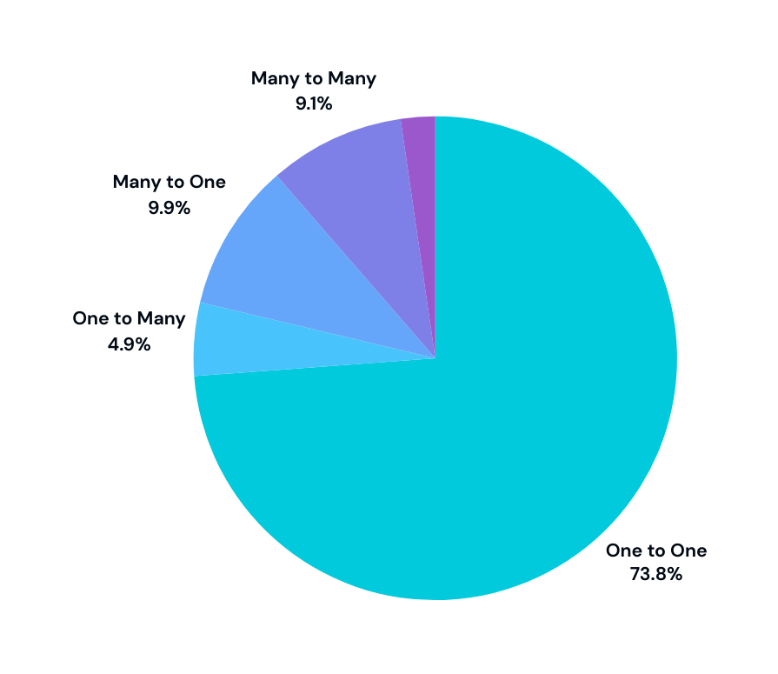
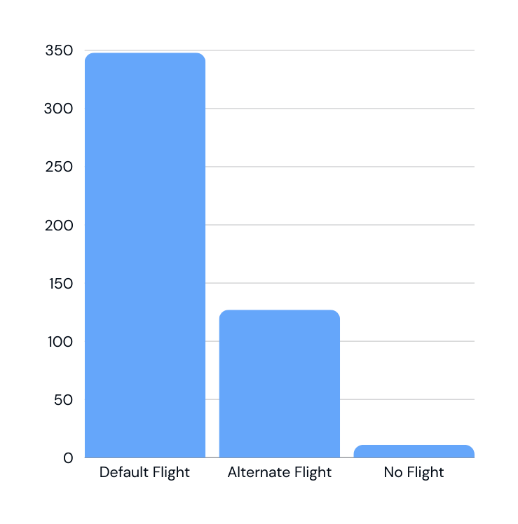
1% Affected Flights
Represents Solution
Represents the number of PNRs allotted
to default flight, alternate flight, and none

Slide 29
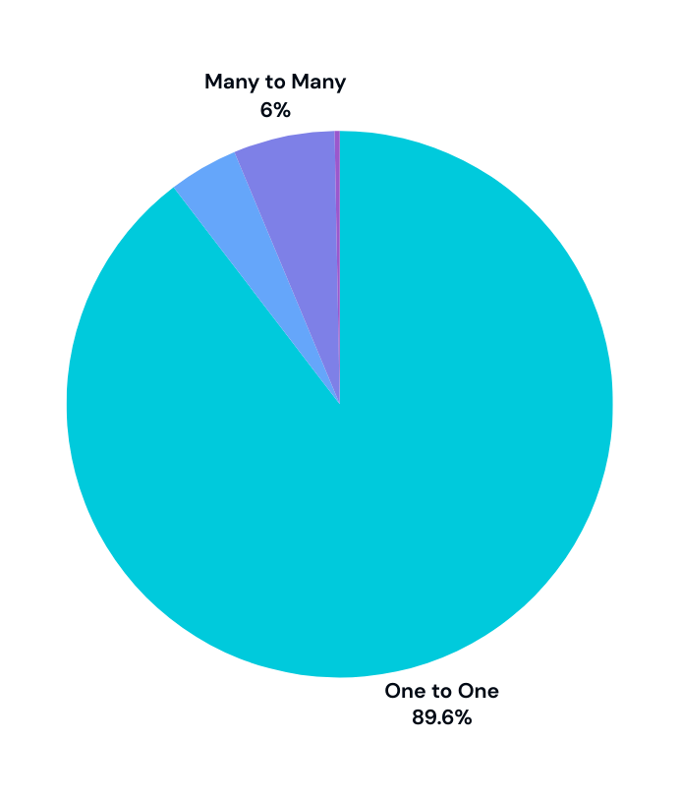
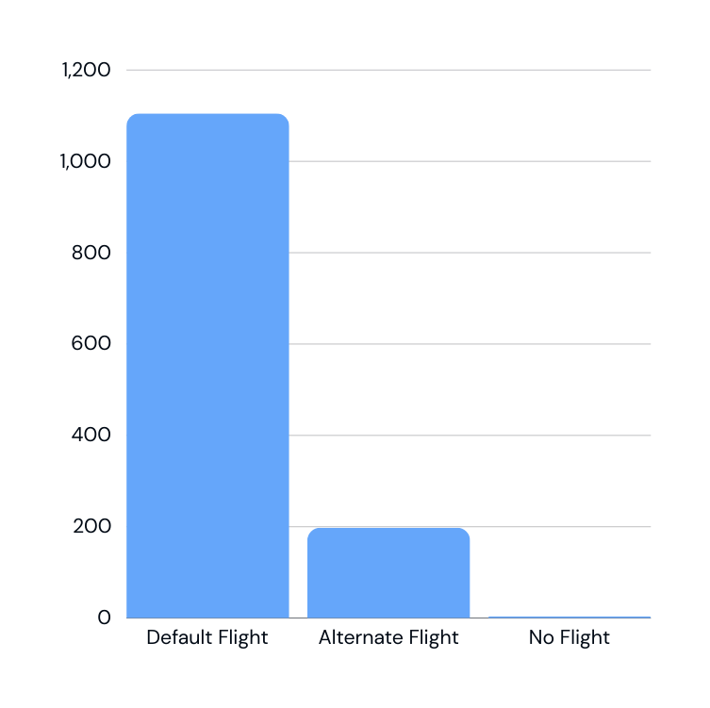
2% Affected Flights
Represents Solution
Represents the number of PNRs allotted
to default flight, alternate flight, and none

Slide 30
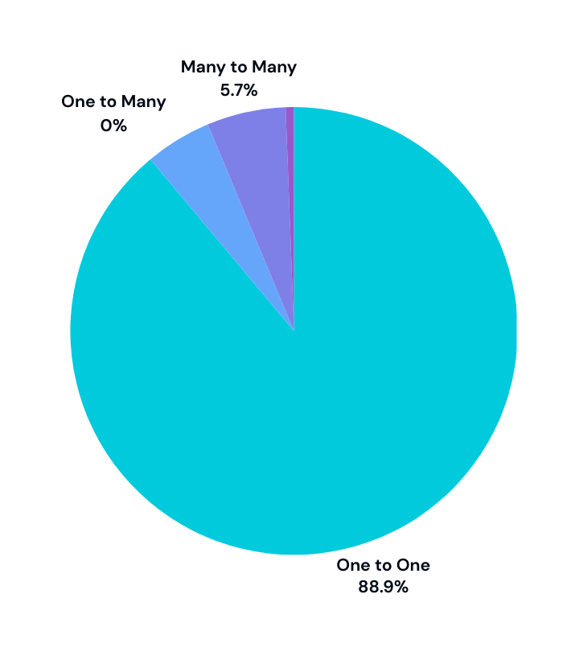
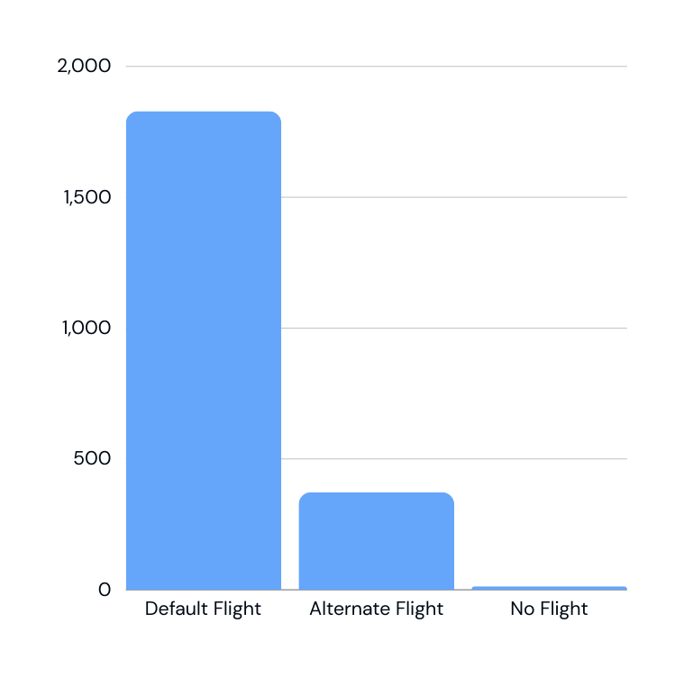
5% Affected Flights
Represents Solution
Represents the number of PNRs allotted
to default flight, alternate flight, and none

Slide 31
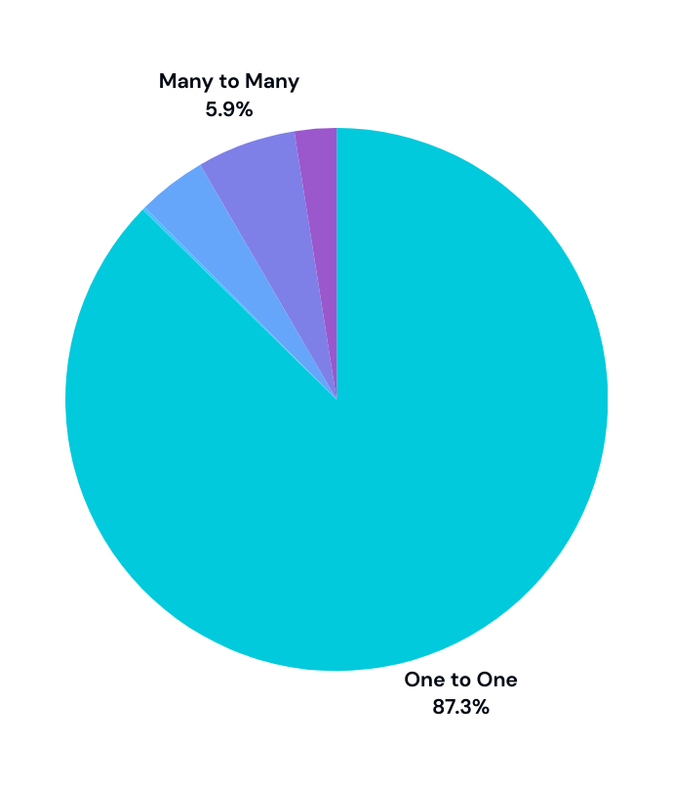
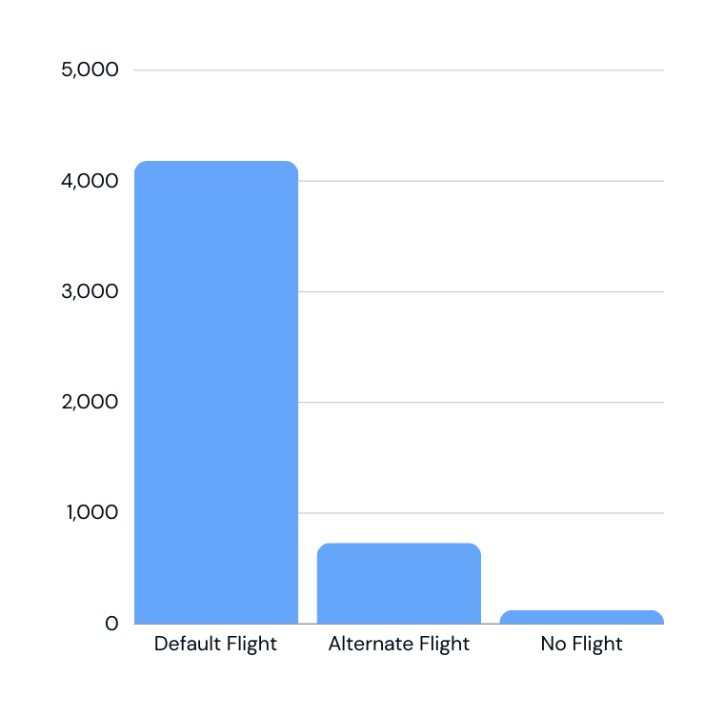
10% Affected Flights
Represents the number of PNRs allotted
to default flight, alternate flight, and none
Represents Solution

Slide 32
Lets see the results of Live Demo !

Slide 33
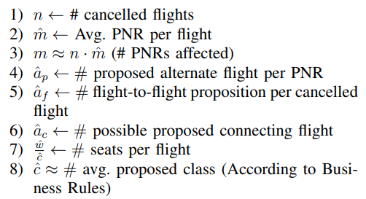
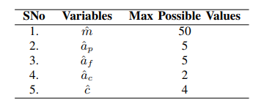
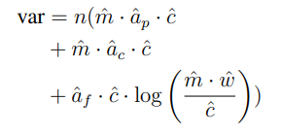
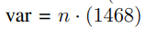
TIME COMPLEXITY

Slide 34
Questions ?

